Slide 1

for Data Science
Installation guide (Anacoda Navigator)

Slide 2
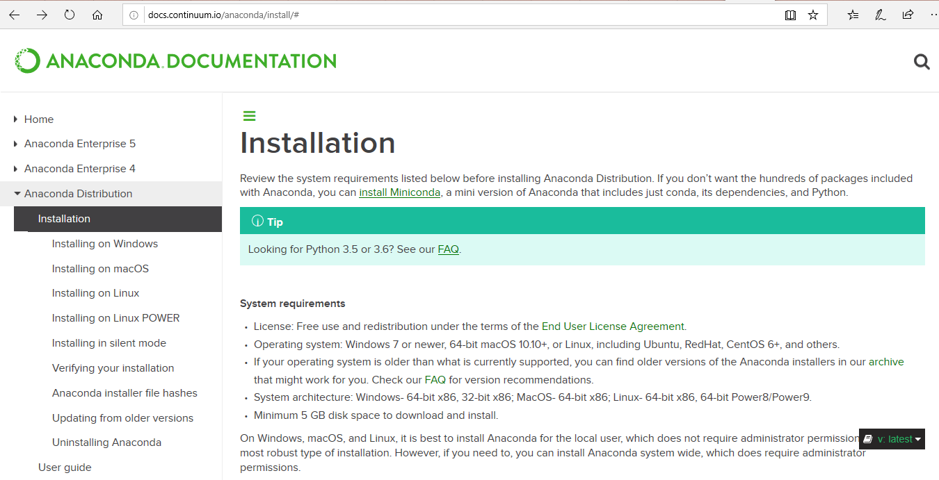
Depending on the machine (Windows/Mac/Linux) follow the installation guides as per the link here : http://docs.continuum.io/anaconda/install/#

Slide 3
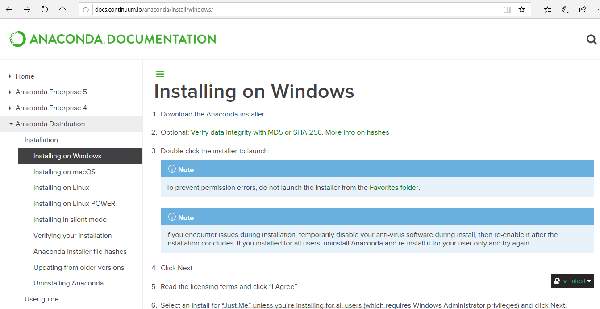
For example : For windows, you should be able to screen similar to below
Click on ‘Download the Anaconda Installer’

Slide 4
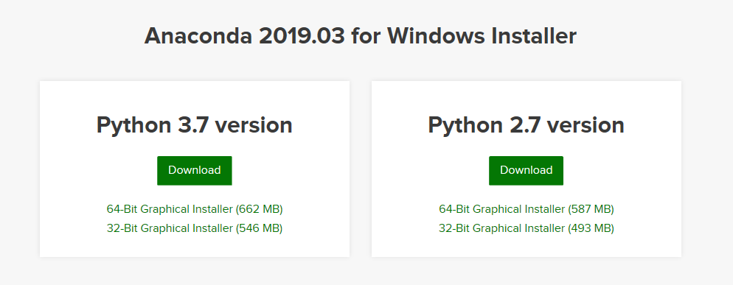
Ensure you select python 3.7 or above.

Slide 5
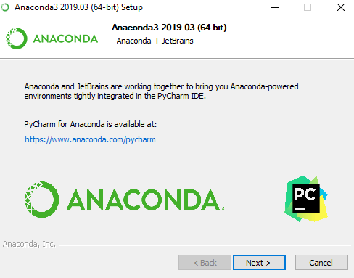
Once downloaded, follow the installation guide to install Anaconda.
All the necessary tools and libraries will be installed along with Anaconda.

Slide 6
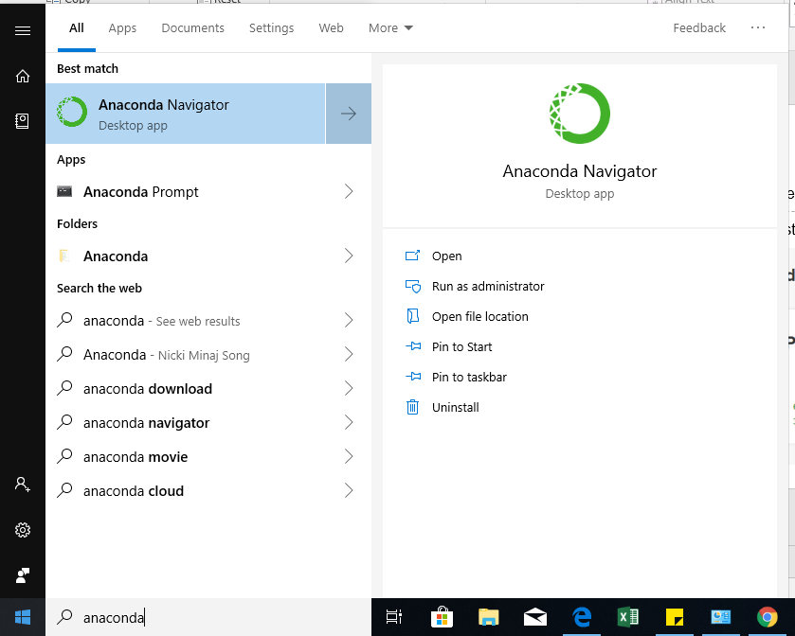
Once the installation is done, you should be able to find Anaconda in the list of installed programs

Slide 7
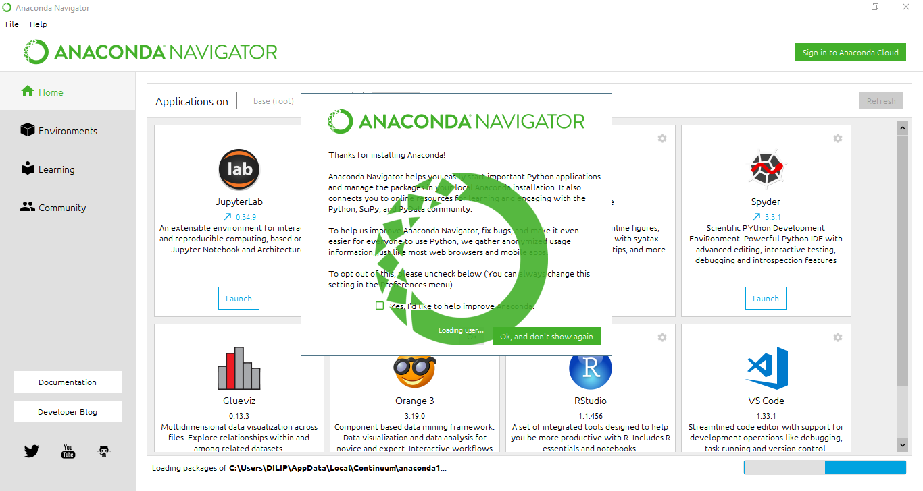
Clicking on ‘Anaconda Navigator’ should take you to a screen like below. You are all set to embark on your data science journey. All the best.

